Slide 1
Credit Card Fraud Detection

Slide 2
Abstract:
Credit Card Fraud can be defined as a case where a person uses someone else’s credit card for personal reasons while the owner and the card-issuing authorities are unaware of the fact that the card is being used.
In the era of digitalization, the need to identify credit card frauds is necessary
To identify credit card fraud detection effectively, we need to understand the various technologies, algorithms and types involved in detecting credit card frauds. The algorithm can differentiate transactions which are fraudulent or not.
Fraud detection involves analysing the activities of users in order to understand the malicious behaviour of users
Malicious behaviour is a broad term including delinquency,fraud,intrusion and account defaulting

Slide 3
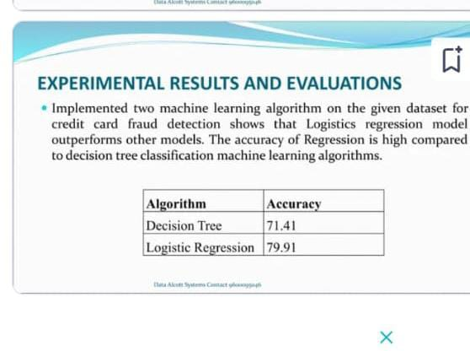
EXIXTING SYSTEM:
previously there exist projects on this particular idea of credit card fraud detection
This is an existing model of credit card fraud detection the algorithms used for this are 1.logistic regression and 2.decision tree

Slide 4
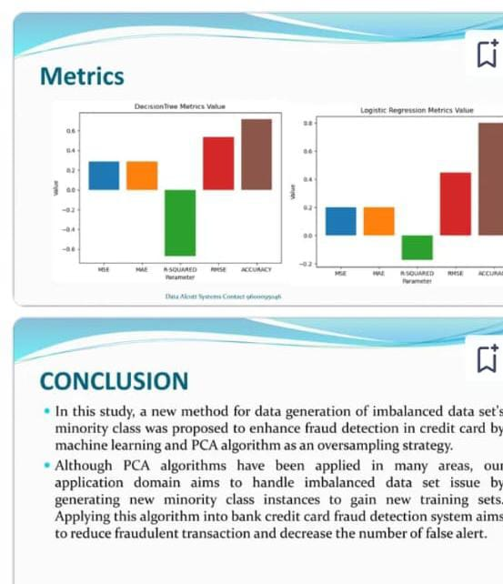
ACCURACY FOR EXIXTING MODEL
by using the above named algorithms they got the accuracies 71.41,79.91 for the decision tree and logistic regression algorithms respectively

Slide 5
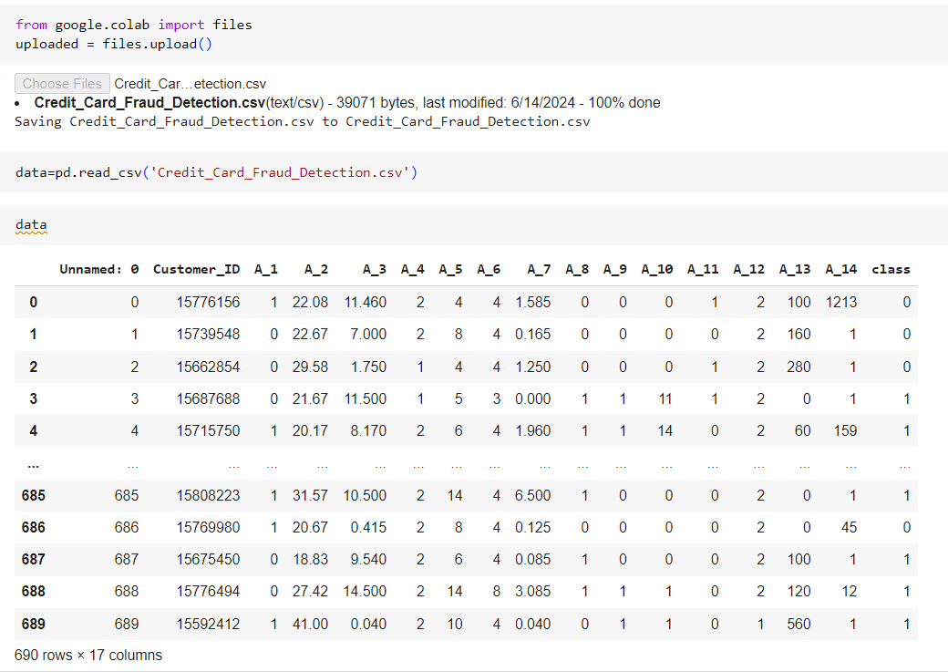
PROPOSED SYSTEM:

Slide 6
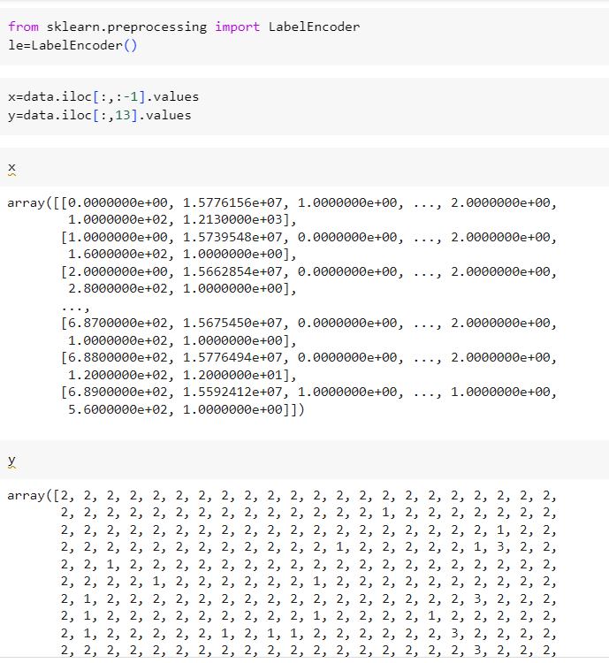

Slide 7
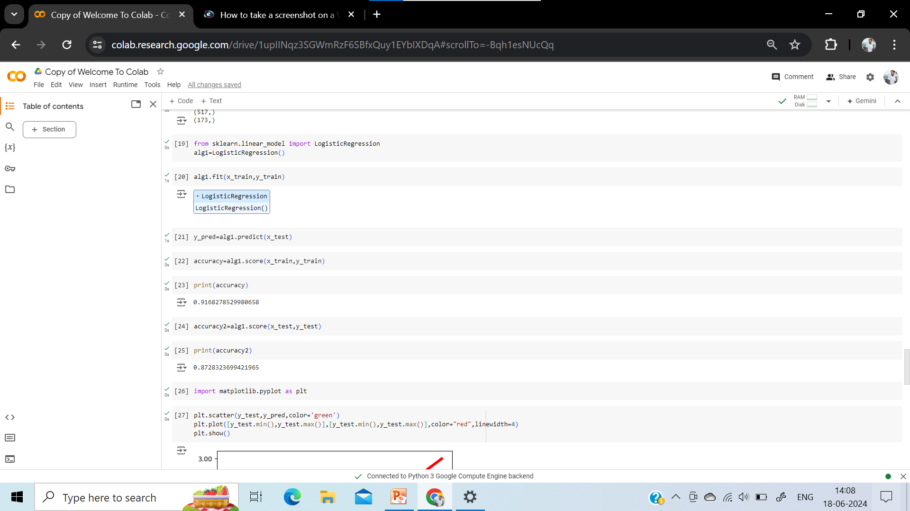

Slide 8
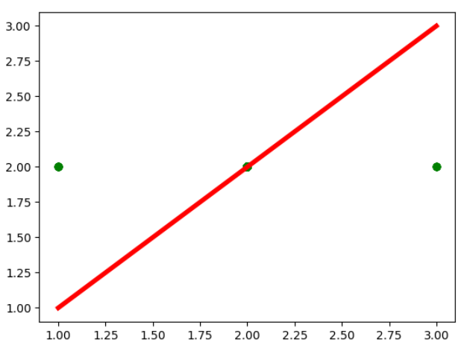
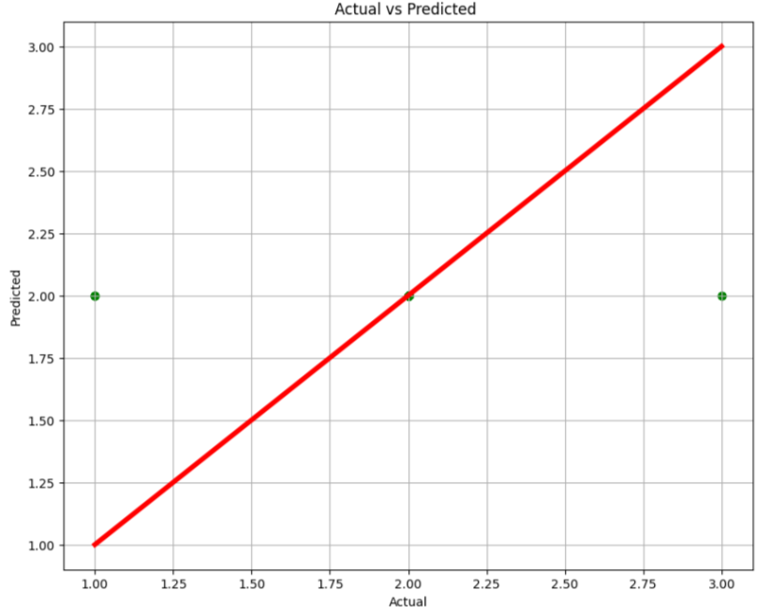
Actual vs Predicted

Slide 9
Technologies Used:
Python v3+
Pandas-for reading the file
numpy-for simple arrays
Matplotlib or seaborn-for plotting and representing confusion matrix colour format
scikit-learn for pre-processing
ALGORITHM USED: " Logistic regression algorithm"

Slide 10
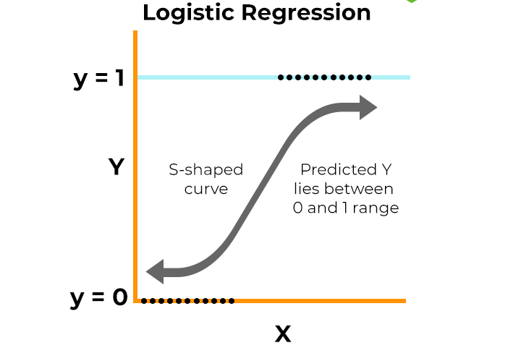

Logistic Regression Algorithm:
Logistic regression is a supervised machine learning algorithm that accomplishes binary classification tasks by predicting the probability of an outcome, event, or observation. The model delivers a binary or dichotomous outcome limited to two possible outcomes: yes/no, 0/1, or true/false
0 – negative class
1 – positive class.
Equation of Logistic Regression
where,
e = base of natural logarithms
value = numerical value one wishes to transform

Slide 11
Conclusion :
Hence, we have acquired the result of an accurate value of credit
Card fraud detection i.e 0.9168278529980658 (91.68%)using a
Logistic regression algorithm with new enhancements.in comparison
To existing modules,this proposed modules is applicable for the largest
data set and provides more accurate results .the logistic regression algorithm
Will provides better performance with many training data,but speed
During testing and applications will still suffer. Usage of more pre-processing
Techniques would also assist.

